Slide 1
CS4101 Introduction to Embedded Systems Lab 12: Access Control Lecture
Prof. Chung-Ta King
Department of Computer Science
National Tsing Hua University, Taiwan

Slide 2
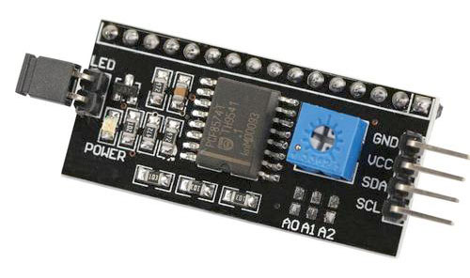
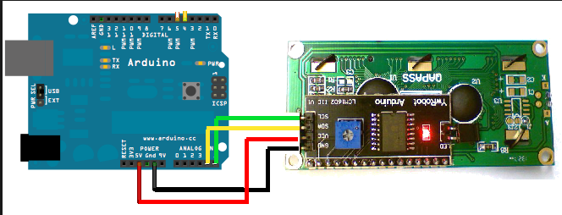
LCM1620 IIC LCD
GND (ground)
VCC (power supply 5V)
SDA (i2c data line)
SCL (i2c clock)
A4
A5

Slide 3
Do you know keypad?
Reference: https://swf.com.tw/?p=921

Slide 4
Keypad
Before, we have learned using Keypad with 8 digital pins.
How can we use Keypad with some resistors and only an analog pin?
Reference: https://swf.com.tw/?p=921

Slide 5
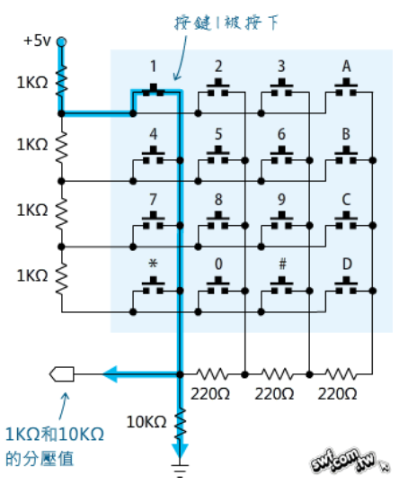
Keypad
We can add 220Ω*3, 1KΩ*4, and 10KΩ*1 to achieve this.
When we press key 1, the circuit will look like this.
The return value by analogRead() can be used to determine which key is pressed.

Slide 6
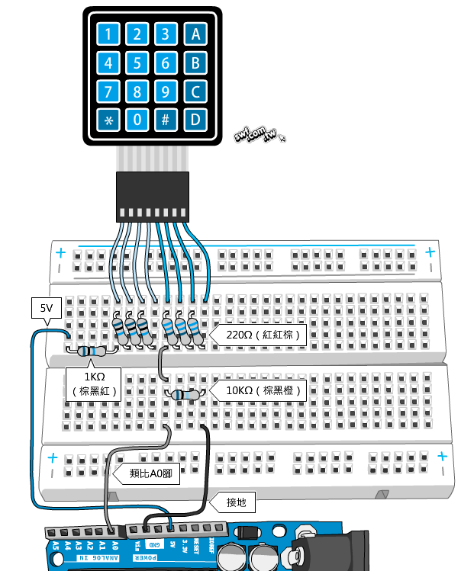
Keypad
The circuit is shown in the picture.

Slide 7
Keypad Sample Code
#include "AnalogMatrixKeypad.h"
// include the file in your lab12 folder
// └── lab12
// ├── lab12.ino
// ├── AnalogMatrixKeypad.h
// └── AnalogMatrixKeypad.cpp
AnalogMatrixKeypad keypad(A0);
// init keypad and keypad input is A0
void setup(){
Serial.begin(9600);
}
void loop(){
char key = keypad.readKey();
// read the keypad value
if (key != KEY_NOT_PRESSED) {
// if keypad is pressed, print the key
Serial.println(key);
}
}

Slide 8
Do you know RFID-RC522?
Reference: https://swf.com.tw/?p=930

Slide 9
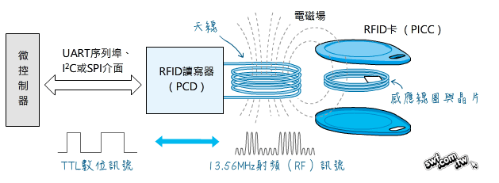
RFID-RC522
Reference: https://swf.com.tw/?p=930

Slide 10
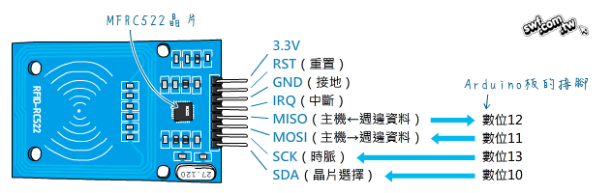
RFID-RC522
BLUE RFID-RC522 use 3.3V

Slide 11
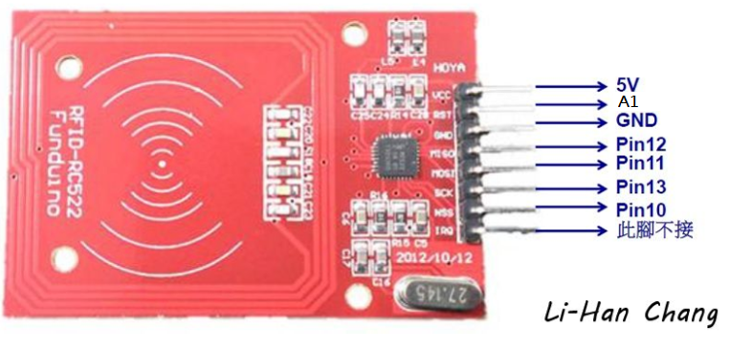
RFID-RC522
RED RFID-RC522 use 5V
Reference: http://lihan.shinyo.bixone.com/Arduino/arduino-2016.08.07.html

Slide 12
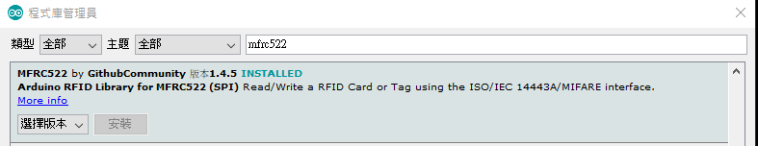
RFID-RC522
Add the library MFRC522

Slide 13
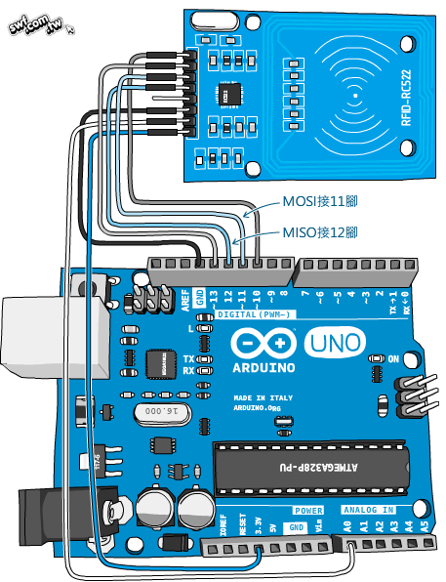
RFID-RC522
BLUE RFID-RC522 use 3.3V
RED RFID-RC522 use 5V
Connect RST to A1 instead of A0

Slide 14
RFID-RC522 Sample Code
#include <SPI.h>
#include <MFRC522.h>
#define RST_PIN A1 // reset pin
#define SS_PIN 10 // select pin for the chip
MFRC522 mfrc522(SS_PIN, RST_PIN); // create MFRC522 object
void setup() {
Serial.begin(9600);
SPI.begin();
mfrc522.PCD_Init(); // init MFRC522
Serial.println("RFID reader is ready!");
}

Slide 15
RFID-RC522 Sample Code
void loop() {
// check if a new card is valid
if (mfrc522.PICC_IsNewCardPresent() && mfrc522.PICC_ReadCardSerial()) {
byte *id = mfrc522.uid.uidByte; // get UID of the card
byte idSize = mfrc522.uid.size; // get UID length
Serial.print("PICC type: "); // show card type
// returned SAK value (mfrc522.uid.sak) tell the card type
MFRC522::PICC_Type piccType = mfrc522.PICC_GetType(mfrc522.uid.sak);
Serial.println(mfrc522.PICC_GetTypeName(piccType));
Serial.print("UID Size: "); // show UID length
Serial.println(idSize);
for (byte i = 0; i < idSize; i++) {
Serial.print("id[");
Serial.print(i);
Serial.print("]: ");
Serial.println(id[i], HEX); // show UID value in hexdecimal
}
Serial.println();
mfrc522.PICC_HaltA(); // halt the card
}
}

Slide 16
Do you know how to read and write data with RFID ?
Reference: https://swf.com.tw/?p=941

Slide 17
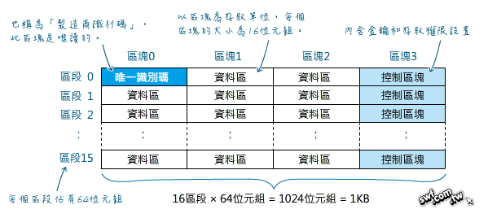
RFID-RC522 Read and Write
Reference: https://swf.com.tw/?p=941
Notes:
每個區16byte：每個區段4個資料區:4*16 = 64byte
共有16個區段

Slide 18
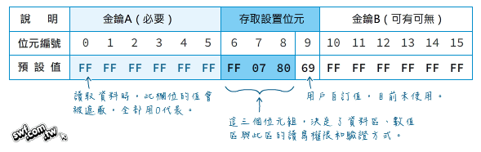
RFID-RC522 Read and Write
Trailer Block
Notes:
3個Block.

Slide 19
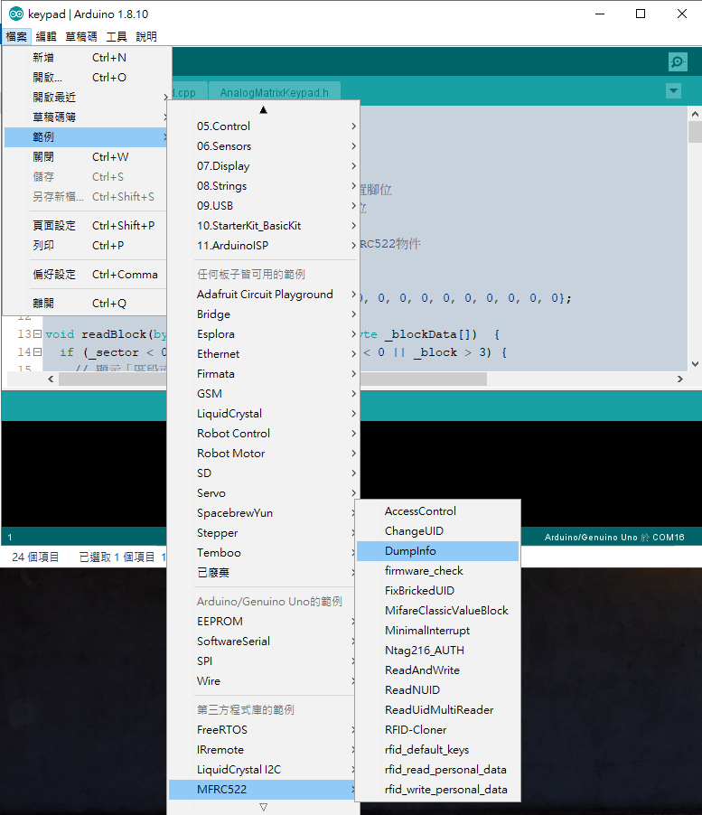
RFID-RC522 Read and Write
Use DumpInfo.ino to see the structure of the card.

Slide 20
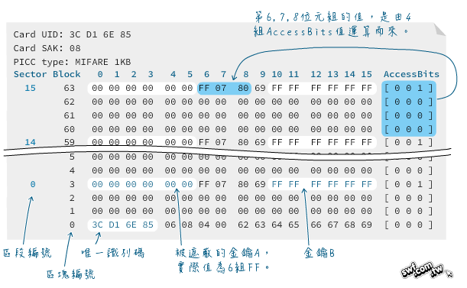
RFID-RC522 Read and Write

Slide 21


RFID-RC522 Read and Write
If we want to read or write data to the card, we have to authenticate認證 it first.
First, declare global variable key and initialize its value in setup().

Slide 22
RFID-RC522 Read and Write
The authentication method is written in the function writeBlock and readBlock. (Check mfrc522.PCD_Authenticate)
Second, how to read or write the block with specific sector and block?
Use the functions provided
void writeBlock(byte _sector, byte _block, byte _blockData[])
void readBlock(byte _sector, byte _block, byte _blockData[])

Slide 23
RFID-RC522 Read and Write
The sector range is 0~15 and the block range is 0~2.
The max length of the written data is 16. However, when you read the data, the buffer size should be 18.
byte blockData[16] = “Hello world!";
Write sector 0 and block 1 with blockData.
writeBlock(0, 1, blockData);
byte buffer[18] = {0, 0, 0, 0, 0, 0, 0, 0, 0, 0, 0, 0, 0, 0, 0, 0, 0, 0};
Read sector 0 and block 1 and store to buffer.
readBlock(0, 1, buffer);
Notes:
Why181?

Slide 24
RFID-RC522 Read and Write Sample Code
#include <SPI.h>
#include <MFRC522.h>
#define RST_PIN A1 // reset pin
#define SS_PIN 10 // select pin for the chip
MFRC522 mfrc522(SS_PIN, RST_PIN); // create MFRC522 object
MFRC522::MIFARE_Key key;
byte blockData[16] = "Hello World!"; // max write data length is 16
byte clearBlockData[16] = {0,0,0,0,0,0,0,0,0,0,0,0,0,0,0,0};
// use buffer size 18 to store the value
byte buffer[18] = {0, 0, 0, 0, 0, 0, 0, 0, 0, 0, 0, 0, 0, 0, 0, 0, 0, 0};
MFRC522::StatusCode status;
// the following 3 functions are written in the sample_code.ino
void writeBlock(byte _sector, byte _block, byte _blockData[]);
void readBlock(byte _sector, byte _block, byte _blockData[]);
void printRFIDdata();

Slide 25
RFID-RC522 Read and Write Sample Code
void setup() {
Serial.begin(9600);
SPI.begin();
mfrc522.PCD_Init(); // init MFRC522
// init the key with 0XFF
for (byte i = 0; i < 6; i++) {
key.keyByte[i] = 0xFF;
}
Serial.println(F("Please scan MIFARE Classic card..."));
}

Slide 26
RFID-RC522 read and write sample code
void loop() {
// check if a new card is valid
if (mfrc522.PICC_IsNewCardPresent() && mfrc522.PICC_ReadCardSerial()) {
byte *id = mfrc522.uid.uidByte; // get UID of the card
byte idSize = mfrc522.uid.size; // get UID length
Serial.print("PICC type: "); // show card type
// according to SAK value (mfrc522.uid.sak) in response, identify the card type
MFRC522::PICC_Type piccType = mfrc522.PICC_GetType(mfrc522.uid.sak);
Serial.println(mfrc522.PICC_GetTypeName(piccType));
Serial.print("UID Size: "); // show UID length
Serial.println(idSize);
……
writeBlock(15, 0, blockData); // write sector 15 and block 0 with blockData
// writeBlock(15, 0, clearBlockData); // clear data in sector 15 and block 0
readBlock(15, 0, buffer); // Read sector 15 and block 0, store to buffer
printRFIDdata();
// halt the card
mfrc522.PICC_HaltA();
// Stop encryption on PCD, can then read or write sector and block many times
mfrc522.PCD_StopCrypto1();
}
}

Slide 27
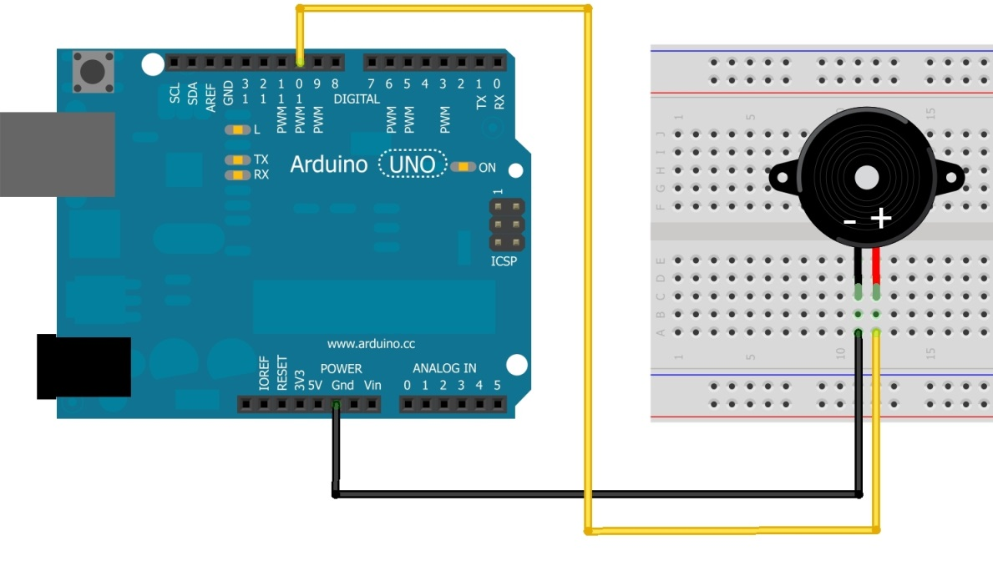
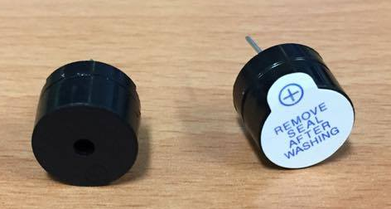
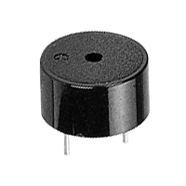
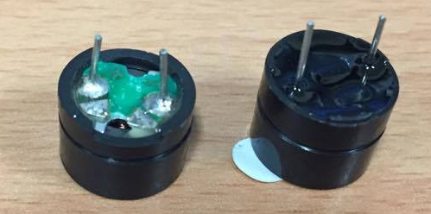
Buzzer
Piezoelectric buzzer:
Contains a metal disc that deforms under a current
By applying an alternating current at a high enough frequency, the disc will move fast to create a sound wave
You have two buzzers; use left one
Use pin 9 instead of 10
Side view
Bottom view
Notes:
壓電材料
Current不同->變形->發出聲音

Slide 28
Playing a Tone
tone(pin, frequency) tone(pin, frequency, duration)
Generates a square wave of the specified frequency (and 50% duty cycle) on a pin
A duration can be specified, otherwise the wave continues until a call to noTone()
Only one tone can be generated at a time. If the tone is playing on the same pin, the call will set its frequency.
For Uno: min frequency 31 Hz; max frequency 65535 Hz

Slide 29
Sample Code for Buzzer
int buzzer = 9;接再pin9
void setup() {
pinMode(buzzer, OUTPUT);
}
void loop() {
for(int i=0; i<10; i++) {
if(i%2 == 0) tone(buzzer,698);
else tone(buzzer, 523);
delay(500);
}
noTone(buzzer); // turn off the buzzer
delay(2000);
}
Notes:
向救護車聲音

